Slide 1
Category review: Chips
September 2025
Retail Analytics

Slide 2
Notes:
To view Privacy video explaining how important data privacy is to Quantium, please click here: https://www.youtube.com/watch?v=Zq1QDAkoRzU
or here Q:\Company Reference\Brand & Design\Brand videos\Q Privacy.mp4
At Quantium, we believe that data is the behavioural footprint of humanity and that it has to be treated with the utmost care and responsibility.
Histories, attitudes, indeed lives are stored within it in ways that aren’t always apparent – and that’s what makes its potential so powerful.
To work with it responsibly, sensitively, we set ourselves the highest data privacy protection and governance standards.
We have spent 17 years perfecting privacy-by-design and secure-by-design principles. Central to this is not holding any personally identifiable information about people –
we neither receive it, and put the necessary protections in place to be unable to decipher it.
Every aspect of handling data is safeguarded: from its de-identification, to its encryption – data security is paramount and of the highest grade.
We pride ourselves on gaining the trust of iconic organisations around the world through years of securely working with their data,
and in turn the trust that builds with their stakeholders.

Slide 3
Executive Summary
01
Task 1
Mainstream young families are the largest chip buyers, driving category sales.
Premium retirees spend more per unit, offering upsell potential.
02
Task 2
Stores 77 & 86 showed significant sales uplift (driven by more customers).
Store 88 showed no significant impact compared to control.

Slide 4
01
Category

Slide 5
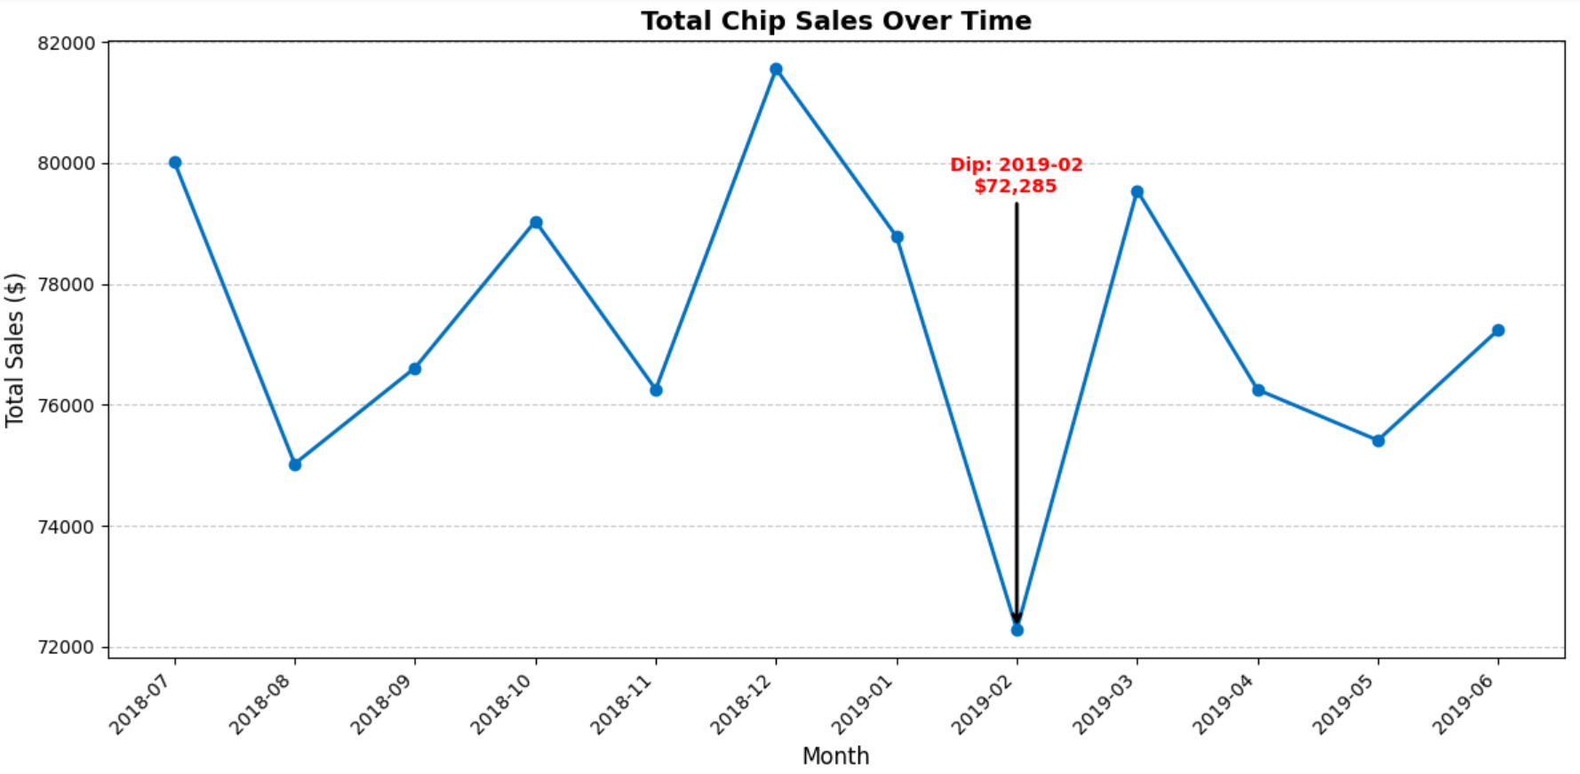
Mainstream Young Families Drive the Highest Chip Sales
Key Insight callout:
Sales fell to their lowest point in Feb 2019 ($72K).
Recovery in March 2019 shows the dip was short-term, not structural.

Slide 6
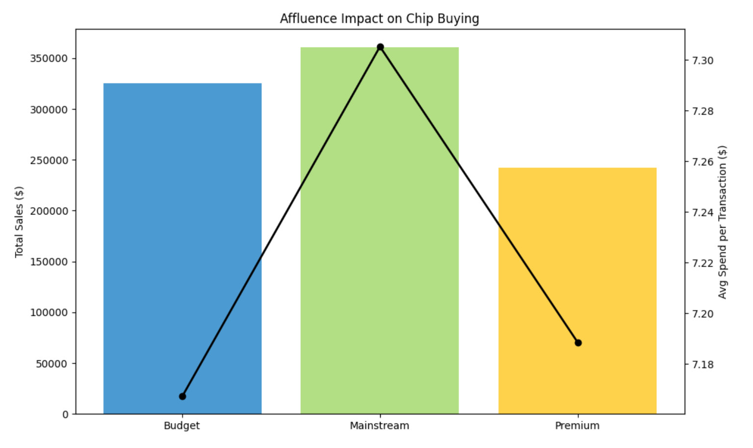
Affluence & Buying Behavior in Chips
Insight: Mainstream young singles/couples and families contribute most; premium retirees spend more per unit.
Callout: Opportunity to upsell premium products to mainstream segments.

Slide 7
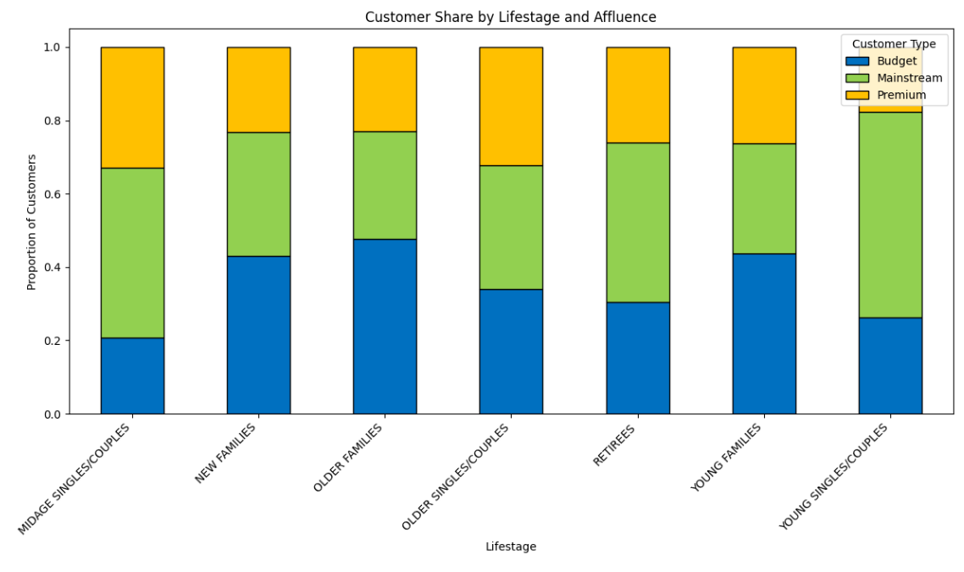
.
Proportion of Customers By Affluence & Life Stage
Key Insights:
Mainstream customers are the largest group in every lifestage.
Premium customers are stronger among retirees and midage couples.

Slide 8
02
Trial store performance

Slide 9
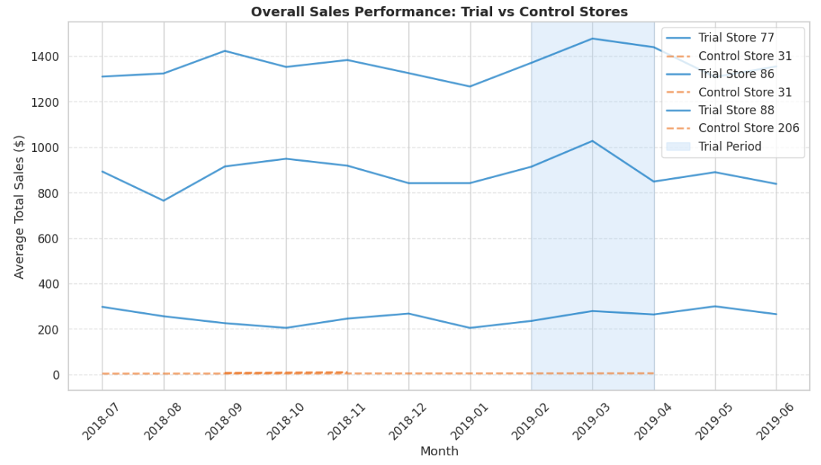




Trial vs Control Sales Performance
Key Insight Callout:
Trial stores show higher sales uplift vs controls during Feb–Apr.
Sales trend sustained beyond trial period, indicating lasting impact.

Slide 10
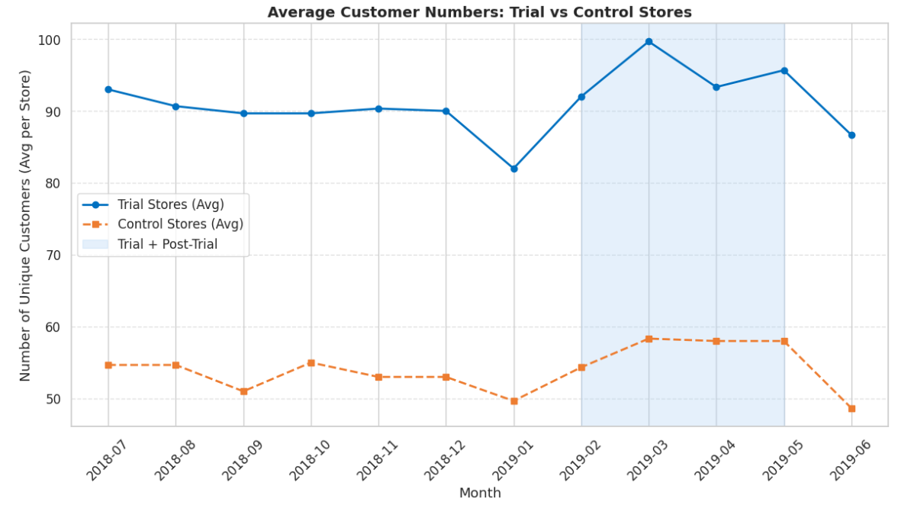
Performance In The Trial Store From Feb – May
Key Insight Callout:
Number of customers increased significantly in trial stores during trial period.
Growth driven by higher footfall, not just more transactions per customer.
Indicates trial layout attracted more shoppers.

Slide 11
Next Steps
Implement layout in stores like 77 & 86, exclude 88-like stores.
Enhance mainstream family promotions.
Test premium upsell offers with retirees & couples.
Monitor long-term performance impact.

